Slide 1

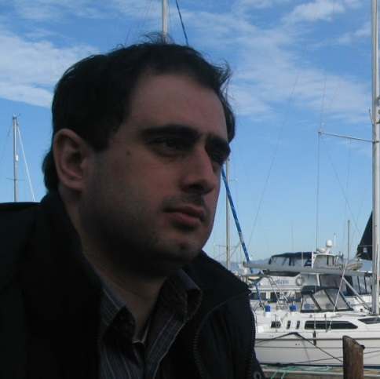
Online Node-weighted Steiner Connectivity Problems
Vahid Liaghat
University of Maryland
MohammadTaghi Hajiaghayi
(UMD)
Debmalya Panigrahi
(Duke)

Slide 2



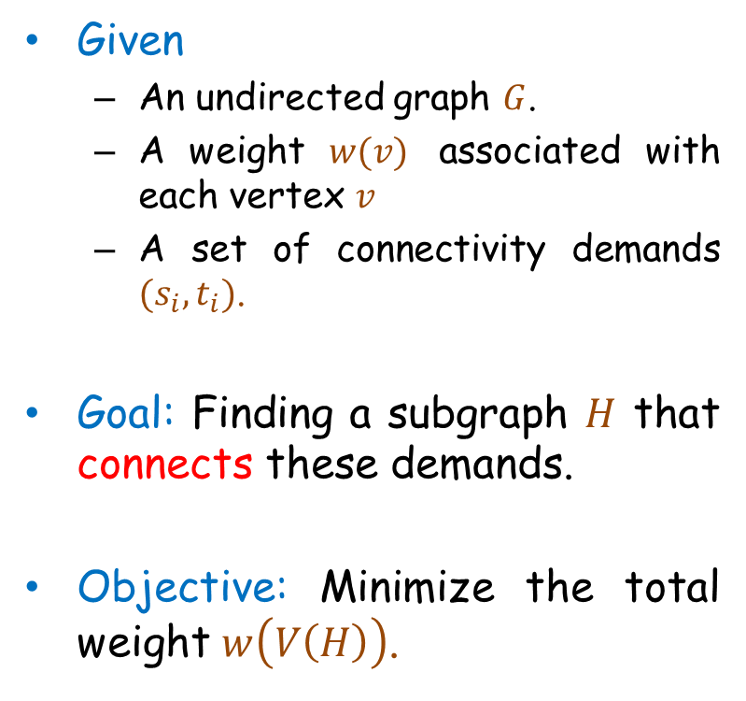



Node-Weighted Steiner Forest
$$s_{1}$$
Given
  An undirected graph $G$.
  A weight $w(v)$ associated with each vertex $v$
  A set of connectivity demands $(s_{i},t_{i})$.
Goal: Finding a subgraph $H$ that connects these demands.
Objective: Minimize the total weight $w\left(V\left(H\right)\right)$.
5
$$t_{1}$$
30
3
$$s_{3}$$
5
5
4
30
10
3
4
$$t_{2}$$
$$s_{2}$$
$$t_{3}$$

Slide 3



Node-Weighted Steiner Forest
$$s_{1}$$
Given
  An undirected graph $G$.
  A weight $w(v)$ associated with each vertex $v$
  A set of connectivity demands $(s_{i},t_{i})$.
Goal: Finding a subgraph $H$ that connects these demands.
Objective: Minimize the total weight $w\left(V\left(H\right)\right)$.
5
$$t_{1}$$
30
3
5
5
4
30
10
3
4
$$t_{2}$$
$$s_{2}$$

Slide 4

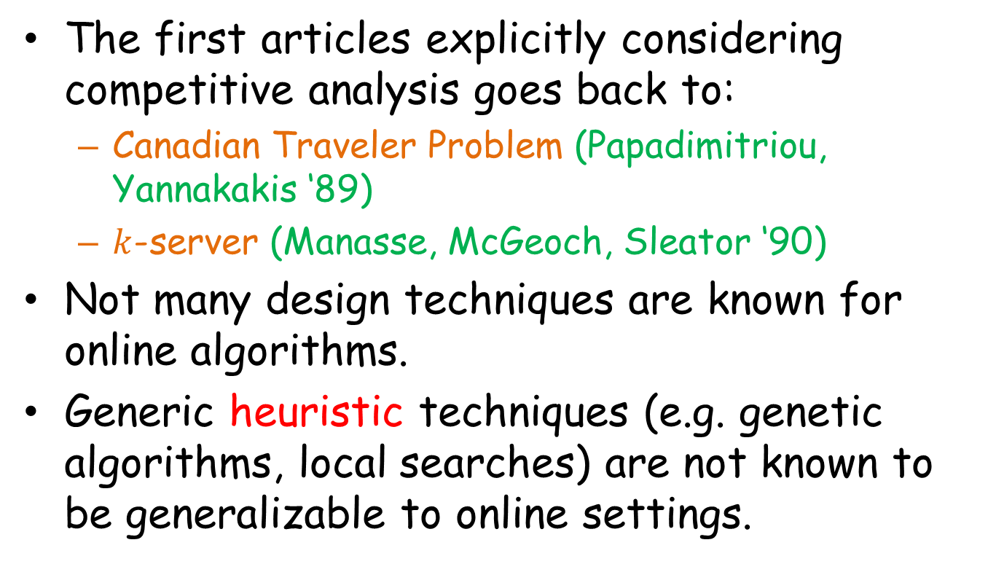
Node-Weighted Steiner Forest
$$s_{1}$$
Given
  An undirected graph $G$.
  A weight $w(v)$ associated with each vertex $v$
  A set of connectivity demands $(s_{i},t_{i})$.
Goal: Finding a subgraph $H$ that connects these demands.
Objective: Minimize the total weight $w\left(V\left(H\right)\right)$.
5
$$t_{1}$$
30
3
$$s_{3}$$
5
5
4
30
10
3
4
$$t_{2}$$
$$s_{2}$$
$$t_{3}$$

Slide 5
Node-Weighted Steiner Forest
$$s_{1}$$
Given
  An undirected graph $G$.
  A weight $w(v)$ associated with each vertex $v$
  A set of connectivity demands $(s_{i},t_{i})$.
Goal: Finding a subgraph $H$ that connects these demands.
Objective: Minimize the total weight $w\left(V\left(H\right)\right)$.
5
$$t_{1}$$
30
3
$$s_{3}$$
5
5
4
30
10
3
4
$$t_{2}$$
$$s_{2}$$
$$t_{3}$$

Slide 6
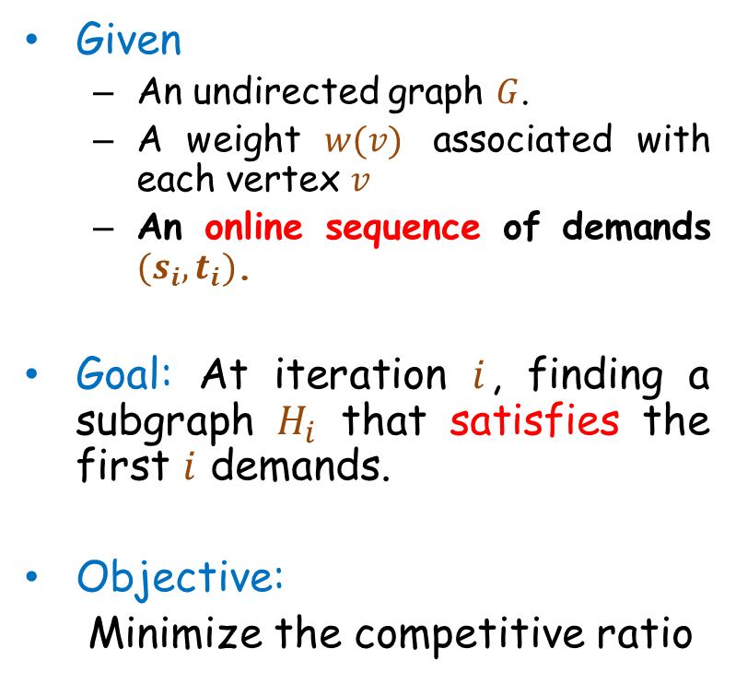
Online Steiner Forest
$$s_{1}$$
Given
  An undirected graph $G$.
  A weight $w(v)$ associated with each vertex $v$
  An online sequence of demands $(s_{i},t_{i})$.
Goal: At iteration $i$, finding a subgraph $H_{i}$ that satisfies the first $i$ demands.
Objective:
Minimize the competitive ratio
5
$$t_{1}$$
30
3
$$s_{3}$$
5
5
4
30
10
3
4
$$t_{2}$$
$$s_{2}$$
$$t_{3}$$

Slide 7

Hardness
Node-weighted Steiner forest
Node-weighted Steiner tree
Set Cover: Given a collection of subsets of a universe, find the minimum number of subsets which cover all the universe.
Special Case
A lower bound of $Ω\left(\frac{\log{k}\log{n}}{\log{\log{k}}+\log{\log{n}}}\right)$ for any online algorithm where $k$ and $n$ denote the size of the universe and the number of sets respectively. [AAABN’09]

Slide 8






Known Results
One more log factor for
prize-collecting variants [HLP’14]
Online Problem | Lower Bound | Upper Bound
Node-weighted Steiner Forest
Node-weighted Steiner Tree
Non-metric Facility Location
Set Cover
Special Case
$$Ω\left(\frac{\log^{2}{n}}{\log{\log{n}}}\right)$$
$O(\log^{3}{n})$ [HLP’13]
$$Ω\left(\frac{\log^{2}{n}}{\log{\log{n}}}\right)$$
$O(\log^{2}{n})$ [NPS’11, HLP’14]
$$Ω\left(\frac{\log^{2}{n}}{\log{\log{n}}}\right)$$
$O(\log^{2}{n})$ [AAABN’04]
$$Ω\left(\frac{\log^{2}{n}}{\log{\log{n}}}\right)$$
$O(\log^{2}{n})$ [AAABN’03]

Slide 9
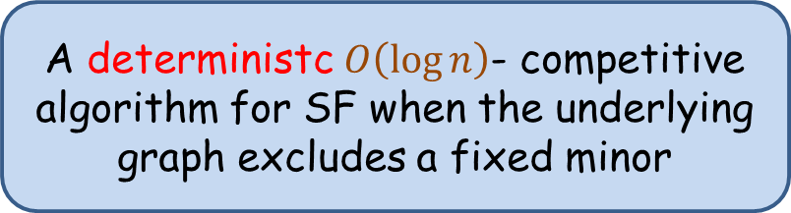
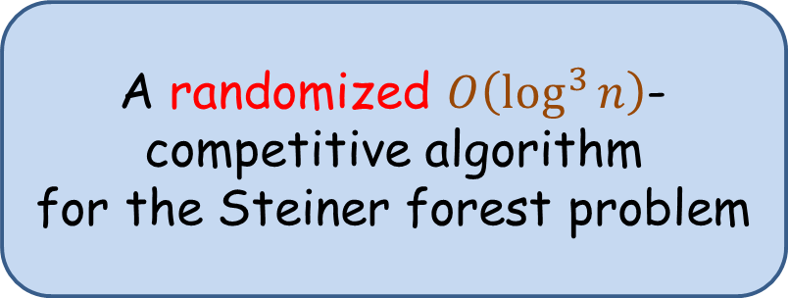
Node-Weighted SF
A randomized $O\left(\log^{3}{n}\right)$- competitive algorithm
for the Steiner forest problem
Results carry over to network design problems characterized by {0,1}-proper functions
Special Case
A deterministc $O\left(\log{n}\right)$- competitive algorithm for SF when the underlying graph excludes a fixed minor

Slide 10
Node-Weighted SF
A randomized $O\left(\log^{3}{n}\right)$- competitive algorithm
for the Steiner forest problem
Results carry over to network design problems characterized by {0,1}-proper functions
Special Case
A deterministc $O\left(\log{n}\right)$- competitive algorithm for SF when the underlying graph excludes a fixed minor

Slide 12
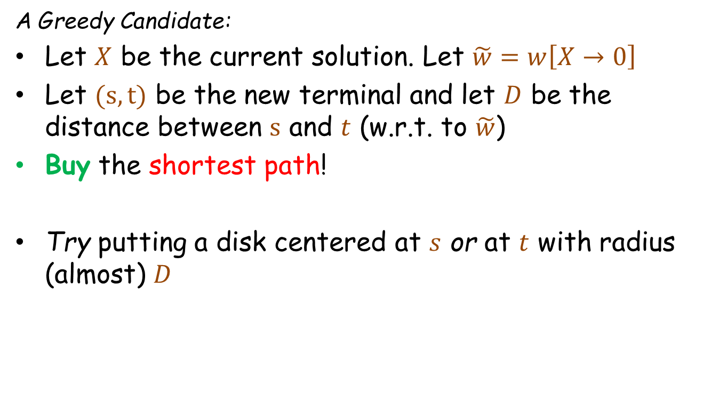
Edge-Weighted Steiner Forest [Berman, Coulston]
A Greedy Candidate:
Let $X$ be the current solution. Let $\tilde{w}=w\left[X→0\right]$
Let $(s,t)$ be the new terminal and let $D$ be the distance between $s$ and $t$ (w.r.t. to $\tilde{w}$)
Buy the shortest path!
Try putting a disk centered at $s$ or at $t$ with radius (almost) $D$

Slide 13






Edge-Weighted Steiner Forest [Berman, Coulston]
Yes? We are good!
Neighborhood Clearance
No? Bad!
Failure witness
Failure witness
$$u_{s}$$
$$u_{t}$$
$$s$$
$$t$$
$$D$$
$$D/4$$

Slide 14


Edge-Weighted Steiner Forest [Berman, Coulston]
$$u_{s}$$
$$u_{t}$$
$$<D/2$$
$$<D/2$$
$$s$$
$$t$$
$$D$$
One layer for every possible radius, rounded up to powers of two.

Slide 15



Node-weighted
$$s$$
$$t$$
$$D$$
For Planar Graphs:
If the degree of the center of spider is large, maybe this cannot happen too often?

Slide 16
Node-weighted
$$s$$
$$t$$
$$D$$
How about the general graphs?
Connect the terminals to the intersection vertices using a competitive facility location algorithm

Slide 17
Node-Weighted SF
A randomized $O\left(\log^{3}{n}\right)$- competitive algorithm
for the Steiner forest problem
Results carry over to network design problems characterized by {0,1}-proper functions
Special Case
A deterministc $O\left(\log{n}\right)$- competitive algorithm for SF when the underlying graph excludes a fixed minor

Slide 18
12
4
6
1
5
3
0
center
10
boundary
continent

Slide 19
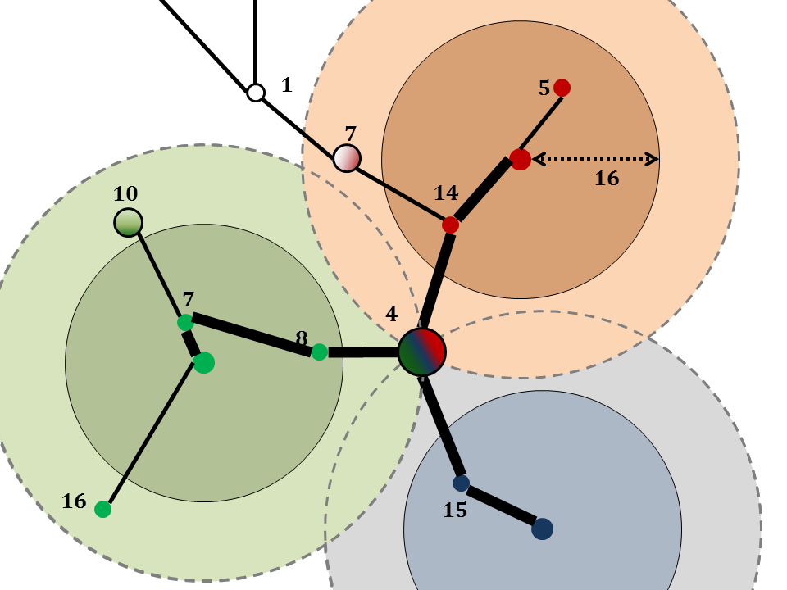
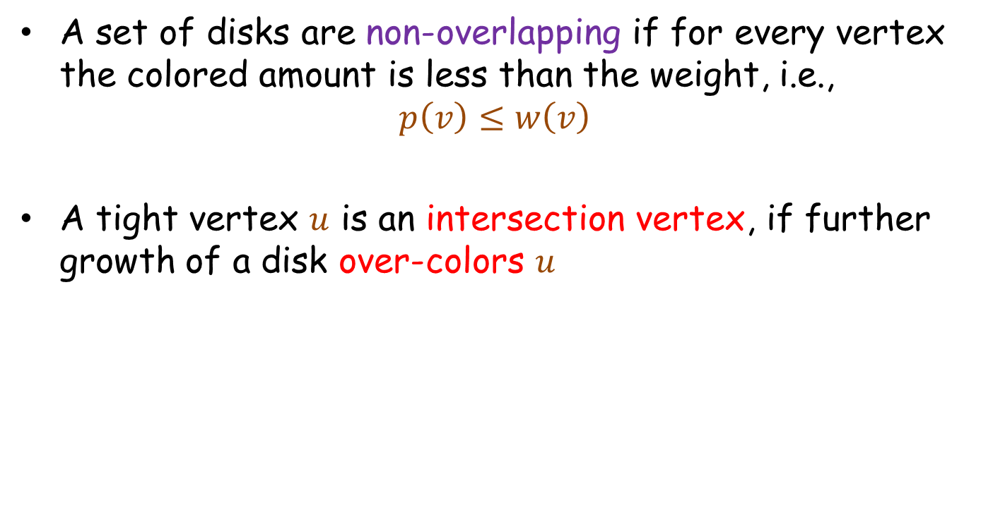
Non-overlapping Disks & Binding Spiders
A set of disks are non-overlapping if for every vertex the colored amount is less than the weight, i.e.,
$$p\left(v\right)≤w\left(v\right)$$
A tight vertex $u$ is an intersection vertex, if further growth of a disk over-colors $u$

Slide 20
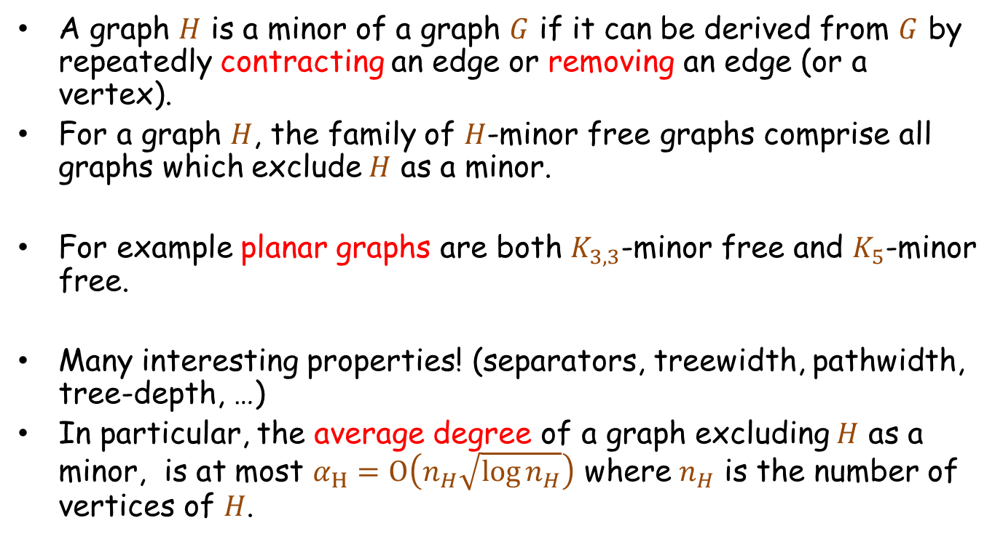
H-Minor Free Graphs
A graph $H$ is a minor of a graph $G$ if it can be derived from $G$ by repeatedly contracting an edge or removing an edge (or a vertex).
For a graph $H$, the family of $H$-minor free graphs comprise all graphs which exclude $H$ as a minor.
For example planar graphs are both $K_{3,3}$-minor free and $K_{5}$-minor free.
Many interesting properties! (separators, treewidth, pathwidth, tree-depth, …)
In particular, the average degree of a graph excluding $H$ as a minor, is at most $α_{H}=O\left(n_{H}\sqrt{\log{n_{H}}}\right)$ where $n_{H}$ is the number of vertices of $H$.

Slide 21
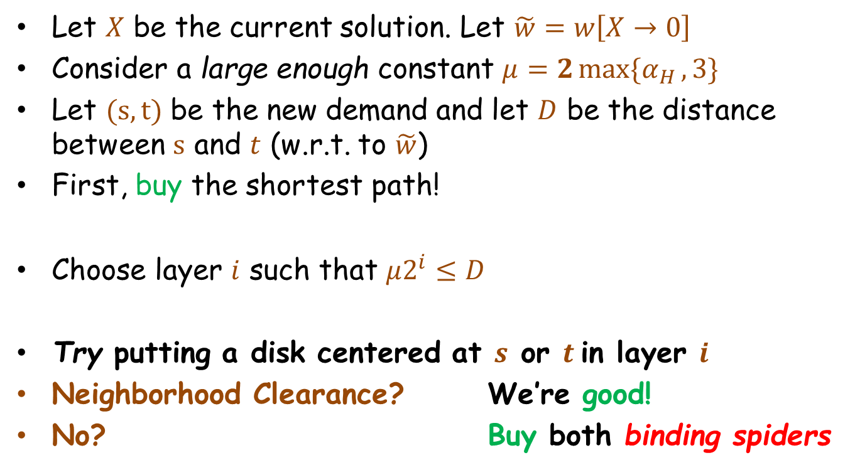
SF in H-Minor-Free Graphs
Let $X$ be the current solution. Let $\tilde{w}=w\left[X→0\right]$
Consider a large enough constant $μ=2\max{\{α_{H },3\}}$
Let $(s,t)$ be the new demand and let $D$ be the distance between $s$ and $t$ (w.r.t. to $\tilde{w}$)
First, buy the shortest path!
Choose layer $i$ such that $μ2^{i}≤D$
Try putting a disk centered at $s$ or $t$in layer $i$
Neighborhood Clearance? We’re good!
No? Buy both binding spiders

Slide 22


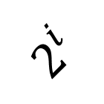



$$2^{i}$$
Failure witnesses
$$c_{s}$$
$$c_{t}$$
$$s$$
$$t$$
$$d^{\tilde{w}}\left(s,t\right)≥{μ 2}^{i}$$

Slide 23

Analysis
$$2^{i}$$
If we charge the cost of our solution to the (radii) of disks, then we have an $O\left(\log{n}\right)$-competitive algorithm!
How can we do that?
The total cost := the shortest path + the binding spider
If we put a new disk, we’re good: $D=O(μ2^{i})$
Otherwise, we buy two spiders.
We have two different cases:
  We are buying an expensive spider
  with at least $μ$ legs!
  Both spiders are cheap
  (at most $μ−1$ legs)
$$c_{s}$$
$$c_{t}$$
$$s$$
$$t$$
$$d^{\tilde{w}}\left(s,t\right)≥{μ 2}^{i}$$

Slide 24

Analysis
$$2^{i}$$
Recall that cost of a spider $≤$ (#legs) $2^{i}$
If both spiders are cheap, charge to the number of connected components.
Otherwise, we show # legs in expensive spiders = O(# disks)
$$c_{s}$$
$$c_{t}$$
$$s$$
$$t$$
$$d^{\tilde{w}}\left(s,t\right)≥{μ 2}^{i}$$

Slide 25
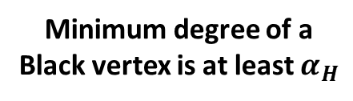

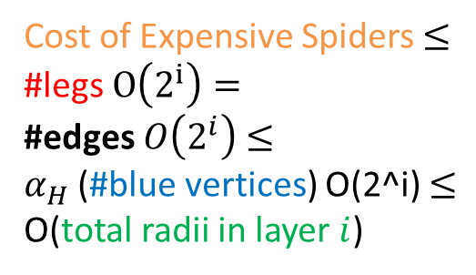
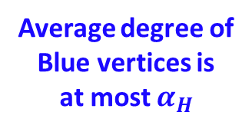
Disks may intersect only on the boundaries.
Cost of Expensive Spiders $≤$
#legs $O\left(2^{i}\right)=$
#edges $O\left(2^{i}\right)$ $≤$
$α_{H}$ (#blue vertices) O(2^i) $≤$
O(total radii in layer $i$)
Average degree at most $α_{H}$
Average degree of
Blue vertices is
at most $α_{H}$
Minimum degree of a
Black vertex is at least $α_{H}$

Slide 26

Summary
We use Disk Painting as a framework for solving node-weighted network design problems
A randomized $O\left(\log^{3}{n}\right)$-competitive algorithm for online network design problems characterized by proper functions
A deterministic $O\left(\log{n}\right)$-competitive algorithm for online network design problems characterized by proper functions when the underlying graph excludes a fixed minor
All the results can be extended to prize-collecting counterparts (tomorrow morning)
Primal-Dual techniques for Group Steiner Tree? Higher Connectivity?
Stochastic settings?
Streaming or parallel models?

Slide 27


Thank You!
Questions?

Slide 28








Hardness
Node-weighted Steiner forest
Node-weighted Steiner tree
Set Cover: Given a collection of subsets of a universe, find the minimum number of subsets which cover all the universe.
Special Case
covered
$$1$$
$$1$$
$$S_{1}$$
$$S_{2}$$
$$e_{1}$$
$$e_{2}$$
$$e_{3}$$
$$e_{4}$$

Slide 29
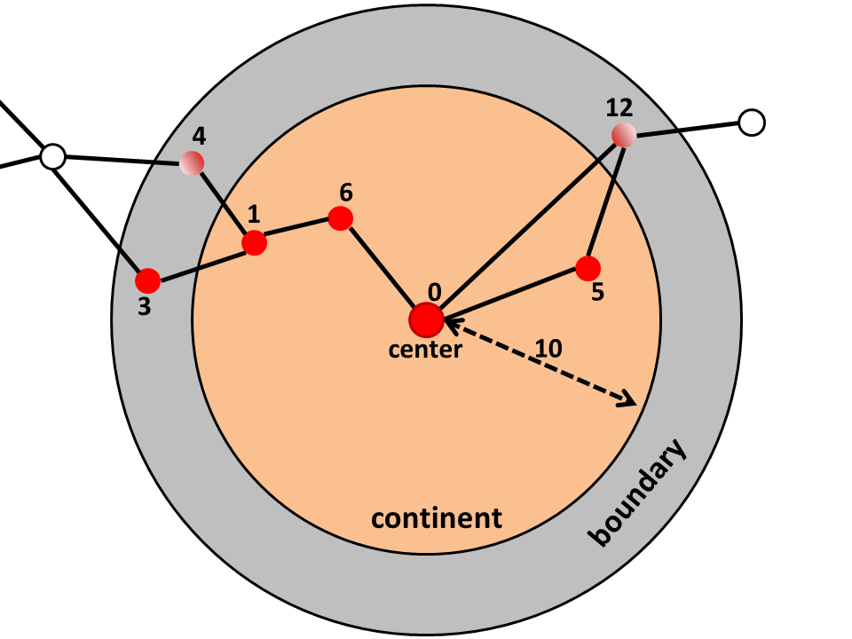
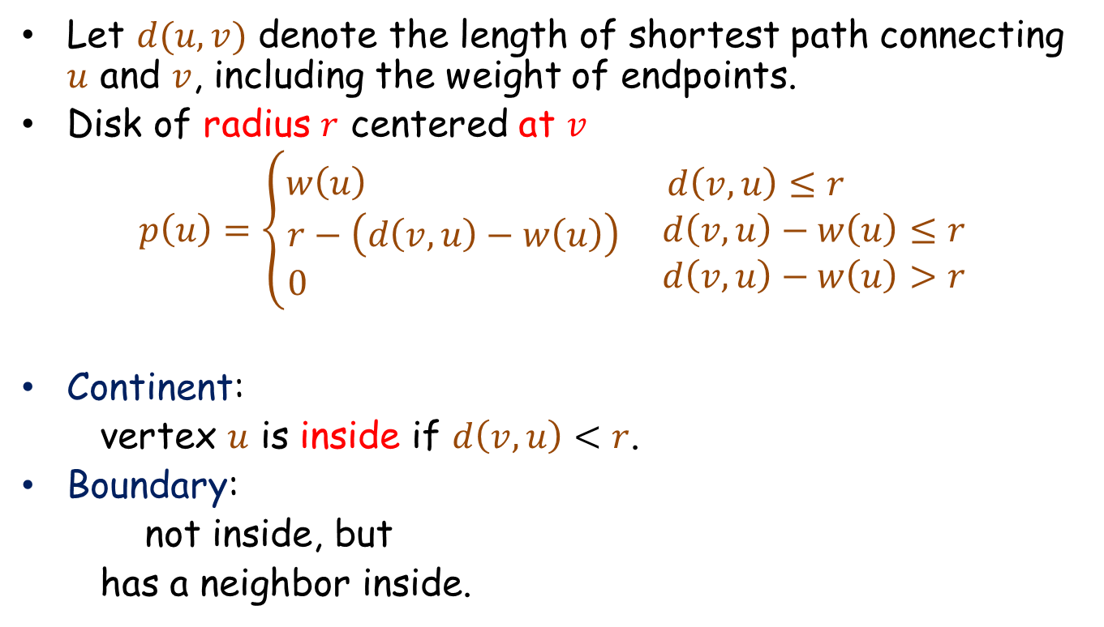
Disks and Paintings
Let $d(u,v)$ denote the length of shortest path connecting $u$ and $v$, including the weight of endpoints.
Disk of radius $r$ centered at $v$
$$p\left(u\right)=\left\{\begin{aligned}w\left(u\right) \\ r−\left(d\left(v,u\right)−w\left(u\right)\right) \\ 0 \end{aligned}\right. \begin{matrix}d\left(v,u\right)≤r \\ d\left(v,u\right)−w\left(u\right)≤r \\ d\left(v,u\right)−w\left(u\right)>r \end{matrix}$$
Continent:
vertex $u$ is inside if $d\left(v,u\right)<r$.
Boundary:
not inside, but
has a neighbor inside.

Slide 30
12
4
6
1
5
3
0
center
10
boundary
continent

Slide 31
Non-overlapping Disks & Binding Spiders
A set of disks are non-overlapping if for every vertex the colored amount is less than the weight, i.e.,
$$p\left(v\right)≤w\left(v\right)$$
A tight vertex $u$ is an intersection vertex, if further growth of a disk over-colors $u$

Slide 32


A Few Observations
We consider non-overlapping disks.
Disks may intersect only on the boundaries.
The radii of all disks are the same, denoted by $r$.
If there are $C$ disks centered at terminals, then $C⋅r≤OPT$

Slide 33




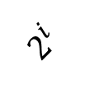
1) $OPT_{i}≤OPT$
The arriving clients are at least $2^{i+1}$ far from each other.
Thus an overlap may acquire only at the boundaries, i.e, the possible facilities.
$$2^{i}$$
$$OPT_{i}≤$$
$$OPT$$

Slide 34
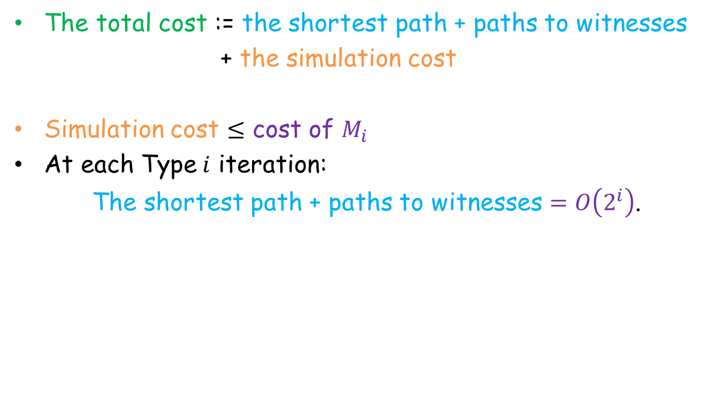



2) $Cost_{i}≤$ O(cost of $M_{i}$)
The total cost := the shortest path + paths to witnesses
+ the simulation cost
Simulation cost $≤$ cost of $M_{i}$
At each Type$i$ iteration:
The shortest path + paths to witnesses $=O\left(2^{i}\right)$.
$M_{i}$ incurs at least $2^{i}$ for every arriving client.
# Type $i$ iterations $=$ O(# clients demanded in layer $i$)

Slide 35
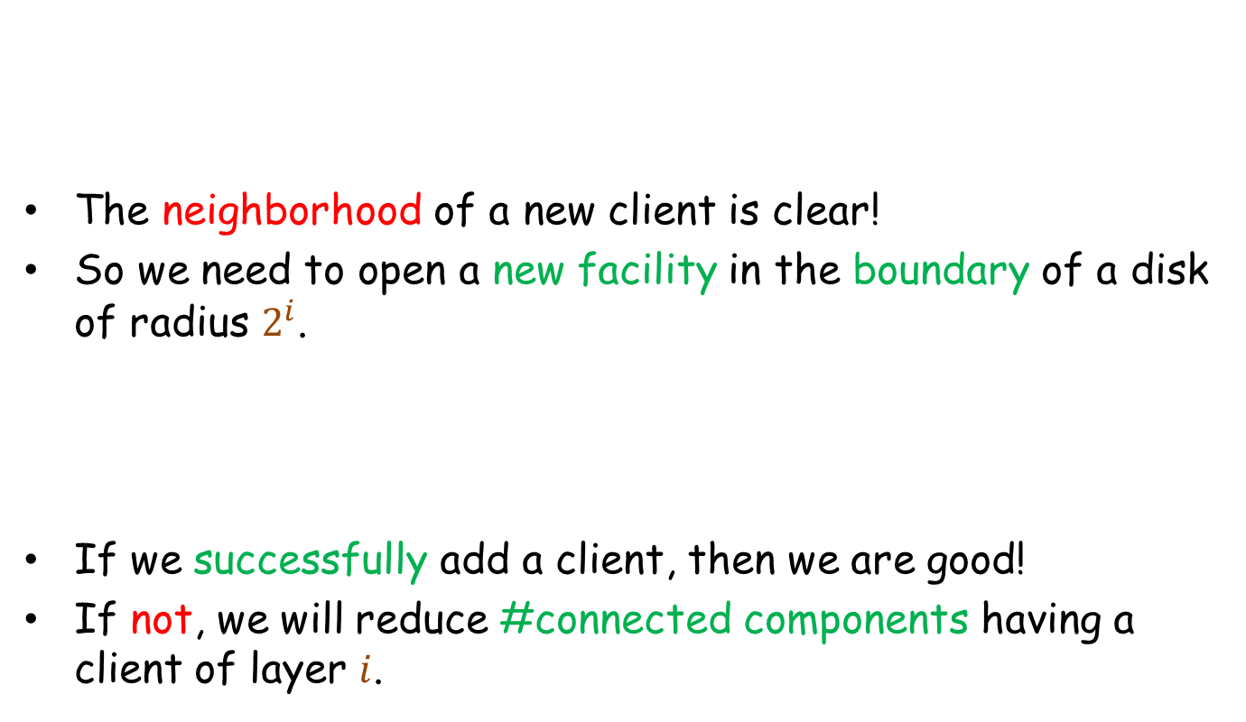


2) $Cost_{i}≤$ O(cost of $M_{i}$)
The neighborhood of a new client is clear!
So we need to open a new facility in the boundary of a disk of radius $2^{i}$.
If we successfully add a client, then we are good!
If not, we will reduce #connected components having a client of layer $i$.
$M_{i}$ incurs at least $2^{i}$ for every arriving client.
# Type $i$ iterations $=$ O(# clients demanded in layer $i$)

Slide 36
References
[1] U. Feige. A threshold of ln n for approximating set cover. JACM’98.
[2] P. Klein and R. Ravi. A nearly best-possible approximation algorithm for node-weighted Steiner trees. Journal of Algorithms’95.
[3] A. Moss and Y. Rabani. Approximation algorithms for constrained node weighted Steiner tree problems. STOC’01, SICOMP’07.
[4] D. Johnson, M. Minkoff, and S. Philips. The prize collecting Steiner tree problem: theory and practice. Soda’00.
[5] Sudipto Guha, Anna Moss, Joseph (Seffi) Naor, and Baruch Schieber. Efficient recovery from power outage. STOC’99.
[6] M.H. Bateni, M.T. Hajiaghayi, V. Liaghat. Improved Approximation Algorithms for (Budgeted) Node-weighted Steiner Problems. Submitted to ICALP’13.
[7] Alon, N., Awerbuch, B., Azar, Y., Buchbinder, N., Naor, J.: The online set cover problem. SIAM J’09.
[8] Naor, J., Panigrahi, D., Singh, M. Online node-weighted steiner tree and related problems. FOCS’11.
[9] Alon, N., Moshkovitz, D., Safra, S. Algorithmic construction of sets for k-restrictions. ACM Trans. Algorithms’06.

Slide 37
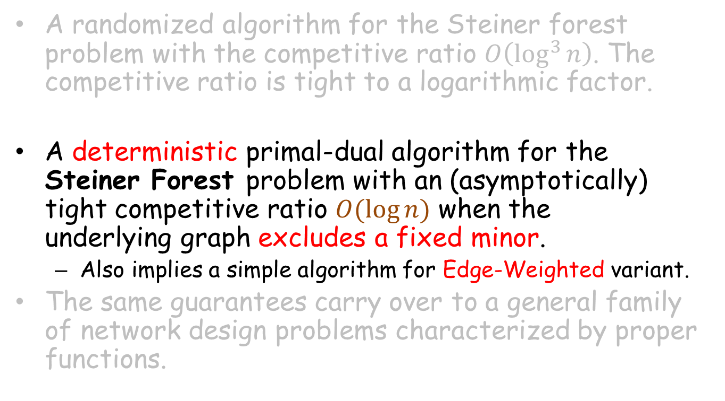
Our Results [Hajiaghayi, Panigrahi, L ’13]
A randomized algorithm for the Steiner forest problem with the competitive ratio $O\left(\log^{3}{n}\right)$. The competitive ratio is tight to a logarithmic factor.
A deterministic primal-dual algorithm for the
Steiner Forest problem with an (asymptotically)
tight competitive ratio $O(\log{n})$ when the
underlying graph excludes a fixed minor.
  Also implies a simple algorithm for Edge-Weighted variant.
The same guarantees carry over to a general family of network design problems characterized by proper functions.

Slide 38
Our Results [Hajiaghayi, Panigrahi, L ’13]
A randomized algorithm for the Steiner forest problem with the competitive ratio $O\left(\log^{3}{n}\right)$. The competitive ratio is tight to a logarithmic factor.
A deterministic primal-dual algorithm for the
Steiner Forest problem with an (asymptotically)
tight competitive ratio $O(\log{n})$ when the
underlying graph excludes a fixed minor.
  Also implies a simple algorithm for Edge-Weighted variant.
The same guarantees carry over to a general family of network design problems characterized by proper functions.

Slide 39
An Algorithm for ST in Minor Free Graphs
Greedy?
  Very reasonable to do! Unfortunately doing that alone fails!
  What saved us before? Buying extra vertices in order to get discount in future
To get a logarithmic competitive ratio, we need to use the disks directly
Reminder: Given a set of non-overlapping disks, one can charge the cost to the (radii of) disks.

Slide 40
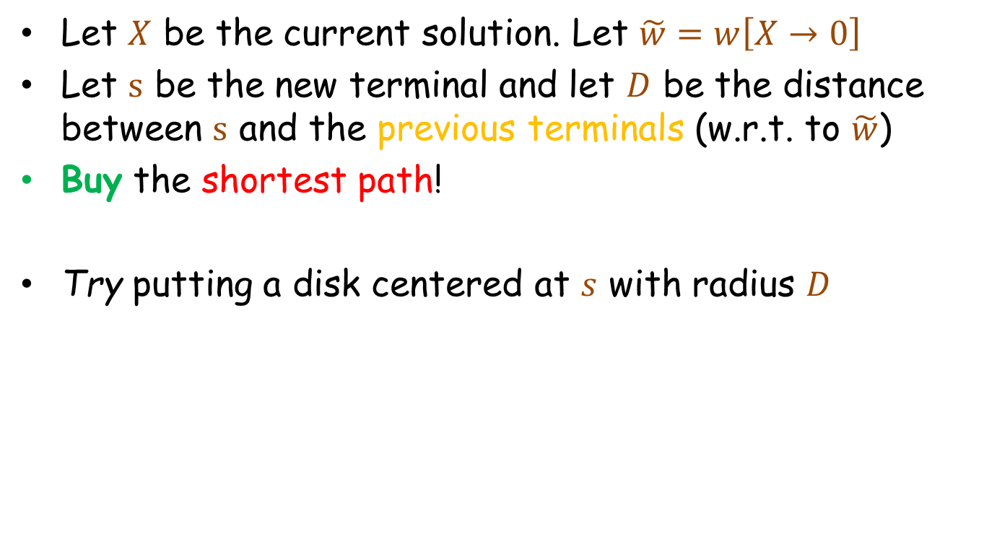
Candidate Algorithm
Let $X$ be the current solution. Let $\tilde{w}=w\left[X→0\right]$
Let $s$ be the new terminal and let $D$ be the distance between $s$ and the previous terminals (w.r.t. to $\tilde{w}$)
Buy the shortest path!
Try putting a disk centered at $s$ with radius $D$

Slide 41
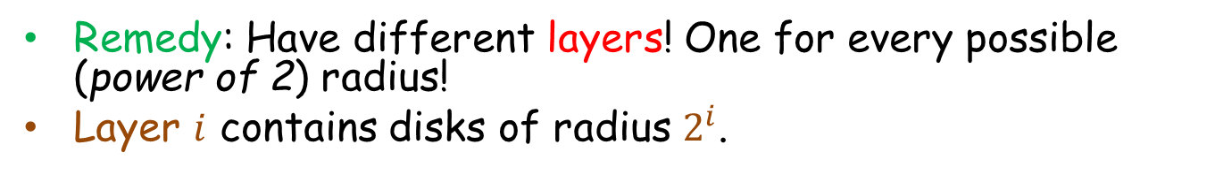
Catch 1
Remedy: Have different layers! One for every possible (power of 2) radius!
Layer $i$ contains disks of radius $2^{i}$.

Slide 42
Catch 2
Remedy: If the degree of the center of spider is large, maybe this cannot happen too often?
Put smaller disks!

Slide 43
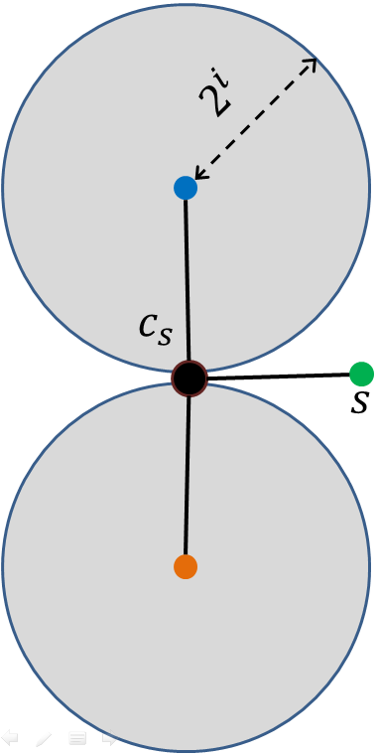
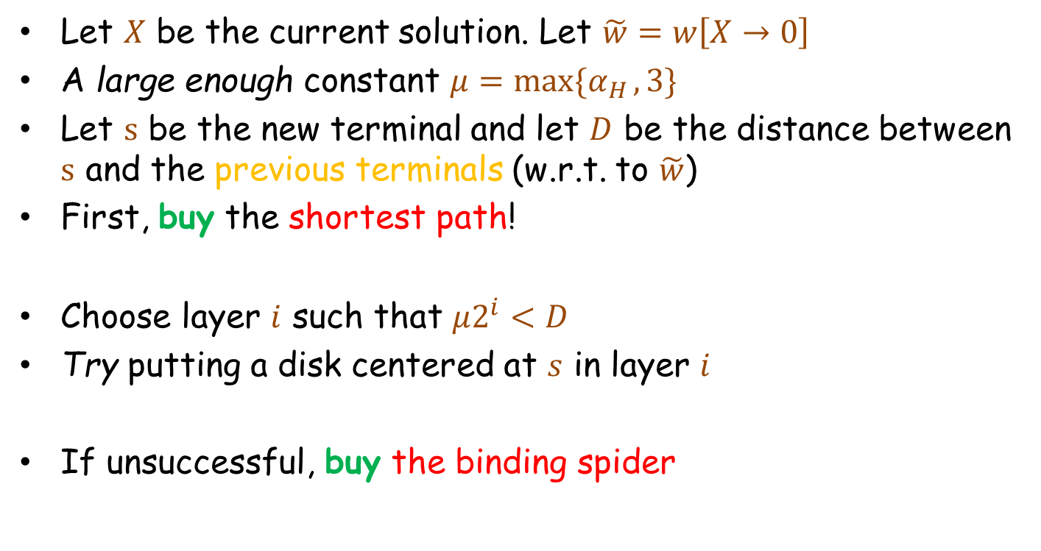
An Algorithm for ST in Minor Free Graphs
Let $X$ be the current solution. Let $\tilde{w}=w\left[X→0\right]$
A large enough constant $μ=\max{\{α_{H },3\}}$
Let $s$ be the new terminal and let $D$ be the distance between $s$ and the previous terminals (w.r.t. to $\tilde{w}$)
First, buy the shortest path!
Choose layer $i$ such that $μ2^{i}<D$
Try putting a disk centered at $s$ in layer $i$
If unsuccessful, buy the binding spider

Slide 44

Analysis
$$2^{i}$$
Again, by charging the cost of our solution to the (radii) of disks, we prove the competitive ratio is $O\left(\log{n}\right)$.
The total cost := the shortest path + the binding spiders
If we put a new disk, we’re good!
If we buy an expensive spider (~ with at least $α_{H}+1$ new legs), then we’re still good!
What if both spiders are cheap?
Every such iteration, reduces the
number of connected components.
#such iterations
$<$ #terminals in the $i^{th}$ layer.
$$c_{s}$$
$$c_{t}$$
$$s$$
$$t$$
$$d^{\tilde{w}}\left(s,t\right)≥{μ 2}^{i}$$

